Slide 1



The lost City

Slide 2
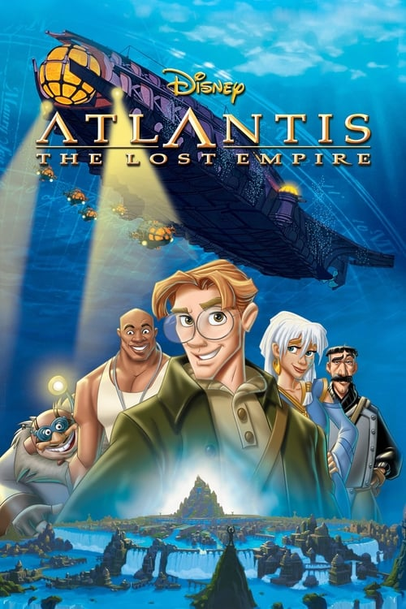
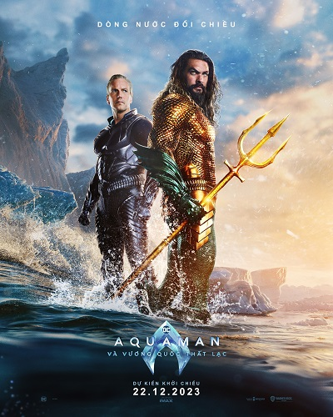
Have you watched these films?

Slide 3
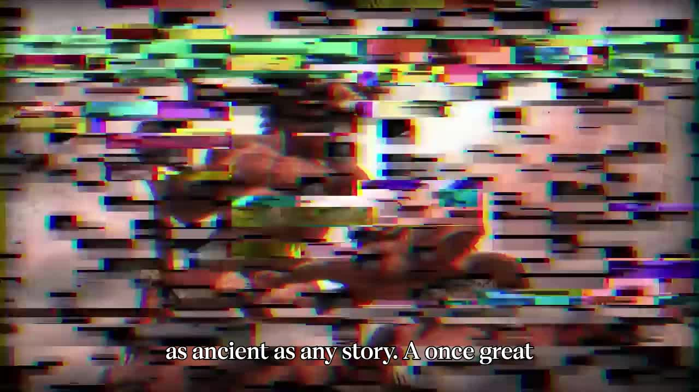
Atlantis: The Lost City

Slide 4
Vocabulary
Word | Definition | Word Category | Example
Fabled | Famous in stories, often with mythical or legendary qualities. | Adjective | "A famous philosopher named Plato first made mention of the fabled island."
Greedy | Having or showing a strong desire for more than one needs or deserves, especially wealth or possessions. | Adjective | "Being very rich and powerful wasn't enough for the greedy people of Atlantis."
Crust | The outermost layer of a planet, especially the solid layer of the Earth. | Noun | "According to the theory, Earth's crust shifted suddenly 12,000 years ago."
Frigid | Very cold in temperature. | Adjective | "The newly frigid temperatures doomed Atlantis..."

Slide 5
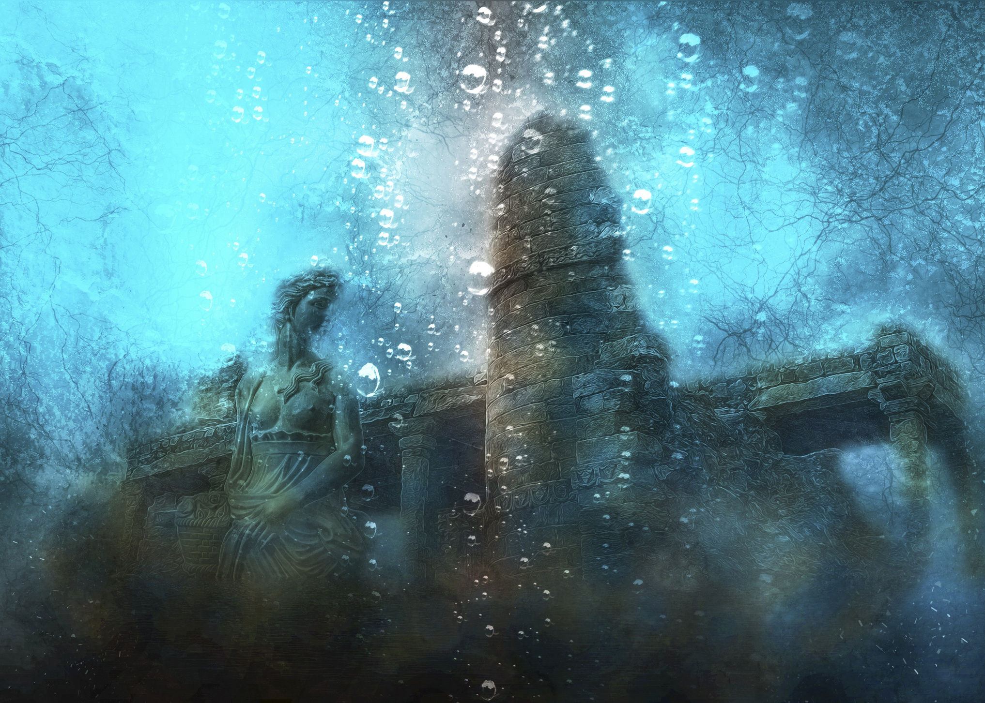
Discussion
  Do you think Atlantis could have been a real place, or was it just a story? Why?
  What do you think happened to Atlantis? Do you think it sank into the ocean?
  If Atlantis was real, what kind of people do you think lived there?

Slide 6
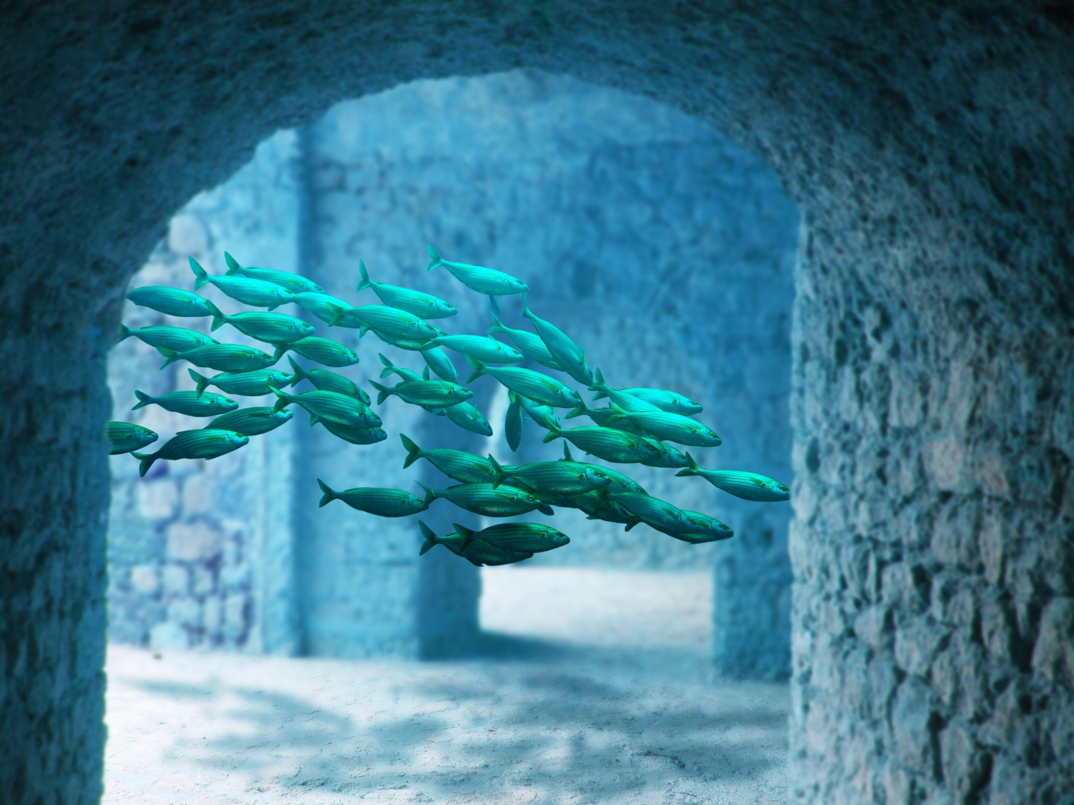
Discussion
  If Atlantis had a great navy, what do you think the people of Atlantis used it for?
  Why do you think the gods were angry with Atlantis? Do you think the gods punished them for a good reason?
  Do you think there are other lost cities like Atlantis hidden under the ocean?

Slide 7
Thank You

